Slide 1

The Problem: Music Genre Classification
Given an audio, corresponding to a song, find the musical genre.
Dataset: GTZAN: 30 second clips for 1000 songs

Slide 2

Initial Setup
Conversion from audio to spectrogram
Exploit architectures designed for image processing, like Convolutional Neural Networks (CNN).
Given a Dataset:
GTZAN: 30 seconds of audio for 1000 songs

Slide 3
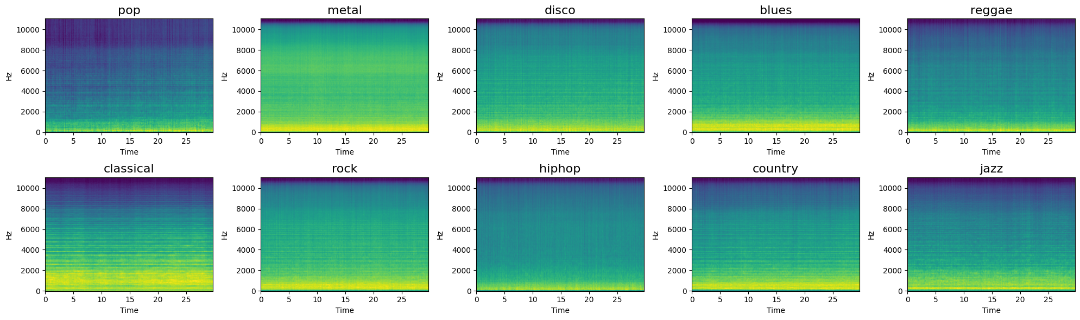
Mean Spectrograms by Genre
The differences between the various genres are clear in some cases and less significant in others.

Slide 4
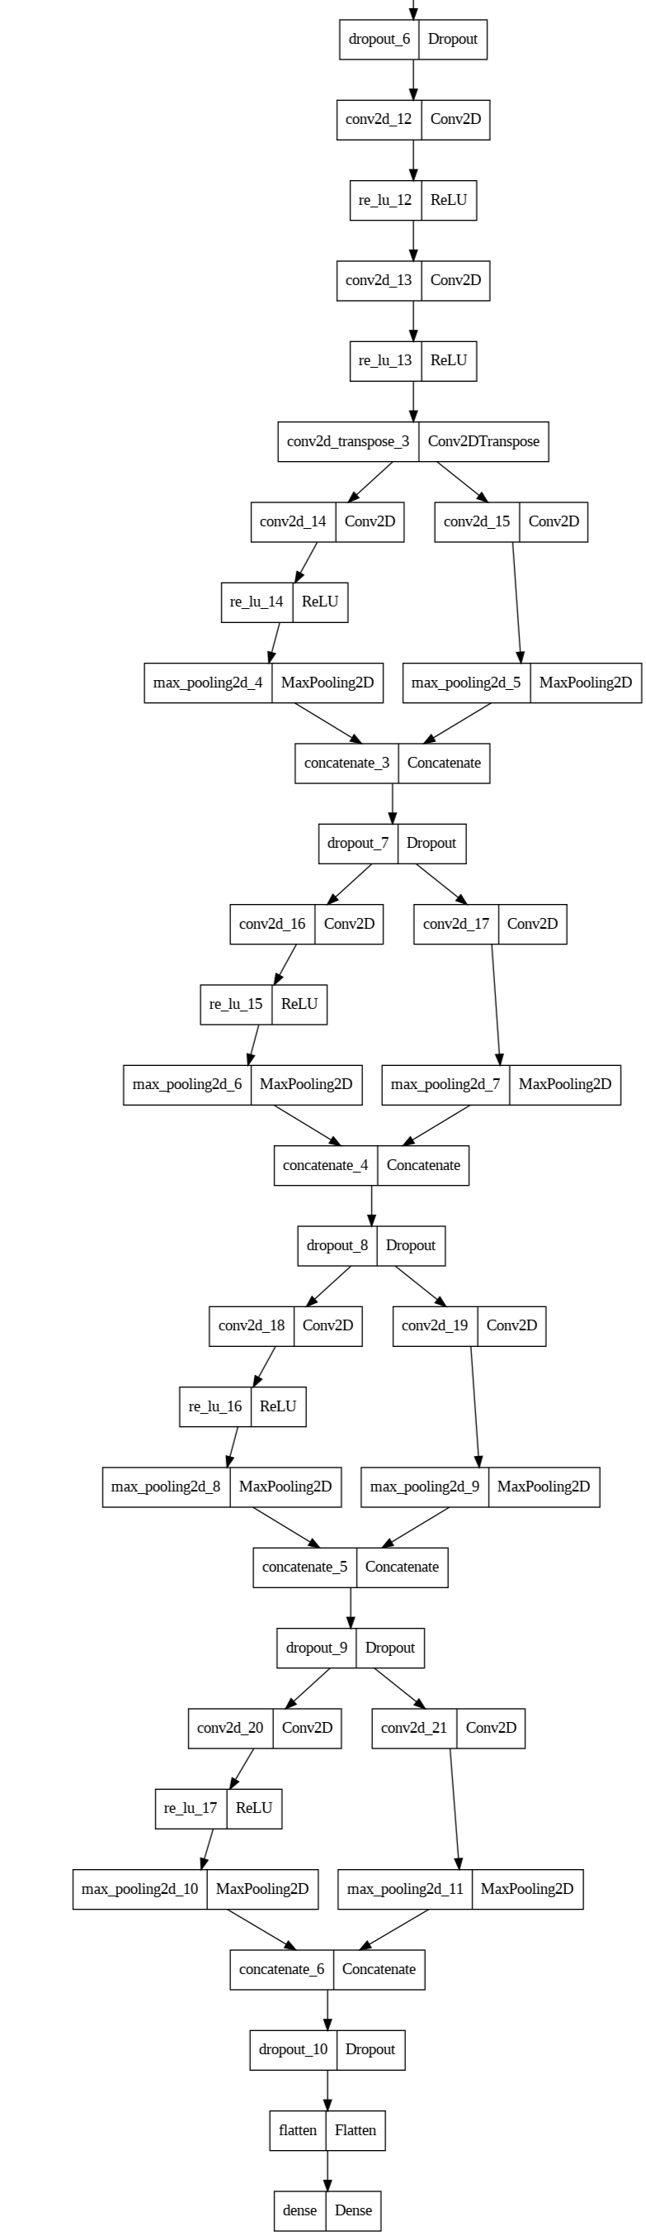
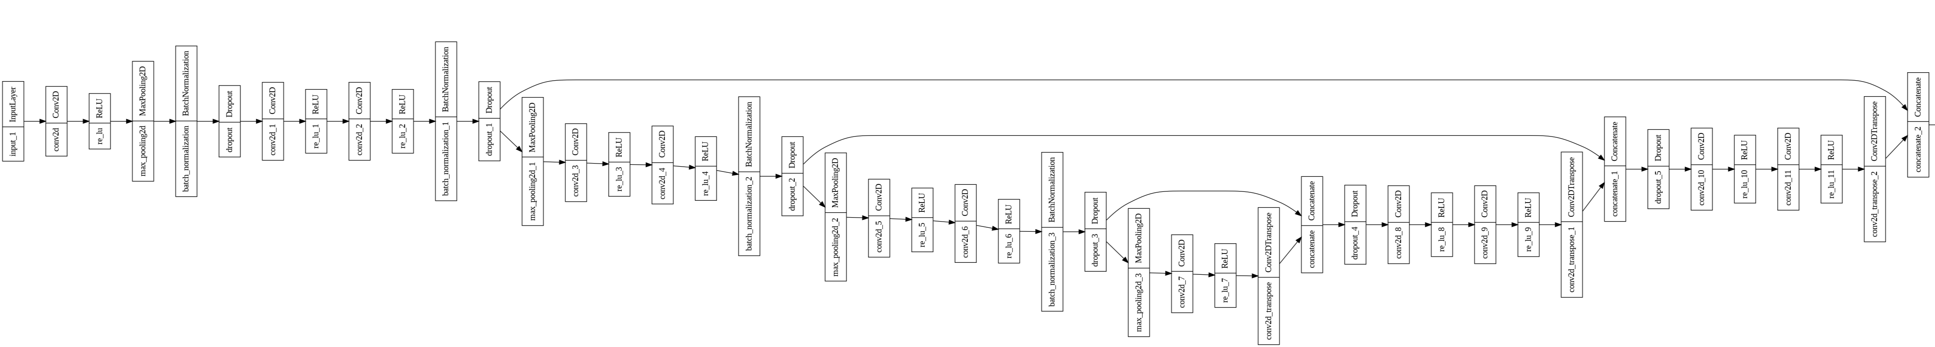
The Architecture
Composed by:
UNet: extract fine grained features
Parallel Convolutions: analyse features

Slide 5
The Difficulties
TensorFlow problems (colab crashes), PReLU, strong overfitting
The problem is quite complex: 10 possible classes.
The dataset is rather small to train a neural network from scratch --> Data Processing is critical in order to avoid overfit.
The model proposed was pretty big, over 300MB. The PReLU was ineffective since It made the training unstable and frequently caused exploding gradients.
Even with a smaller model, colab crashed quite often. So we had to switch to local training, despite its downsides.

Slide 6

Our Approach
We split each song (30s) into 5 different segments, in order to have a bigger dataset. Of course all the segments of a song were all either in the training set or in the validation set.
We used a smaller model, which helped us make the computation feasible and resorted to ReLU, which made the training more stable.
We had to tweak some settings with TensorFlow, using the DataGenerator class, in order to stream the dataset instead of loading It all in memory. This slowed down the training process.

Slide 7

Data Processing
Critical aspects when dealing with dataset of such small size:
We resorted to augmentation. We performed It directly on the spectrogram, following Google's SpecAugment paper. There are more powerful techniques that work directly on waveforms. However, this would slow down the training process by a lot, since we would have to compute the spectrogram of each song in every epoch.
We had to pay close attention with everything we did: compromise between performance and computational feasibility.
Computational resources hindered our efforts: with better augmentation It would be possible to increase the model size without incurring in overfit.

Slide 8
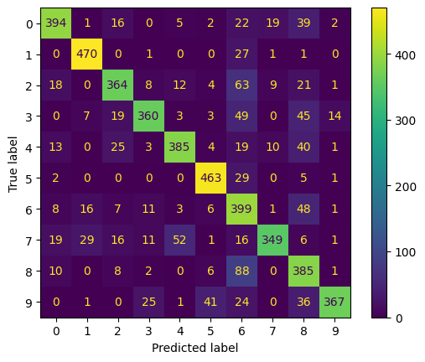
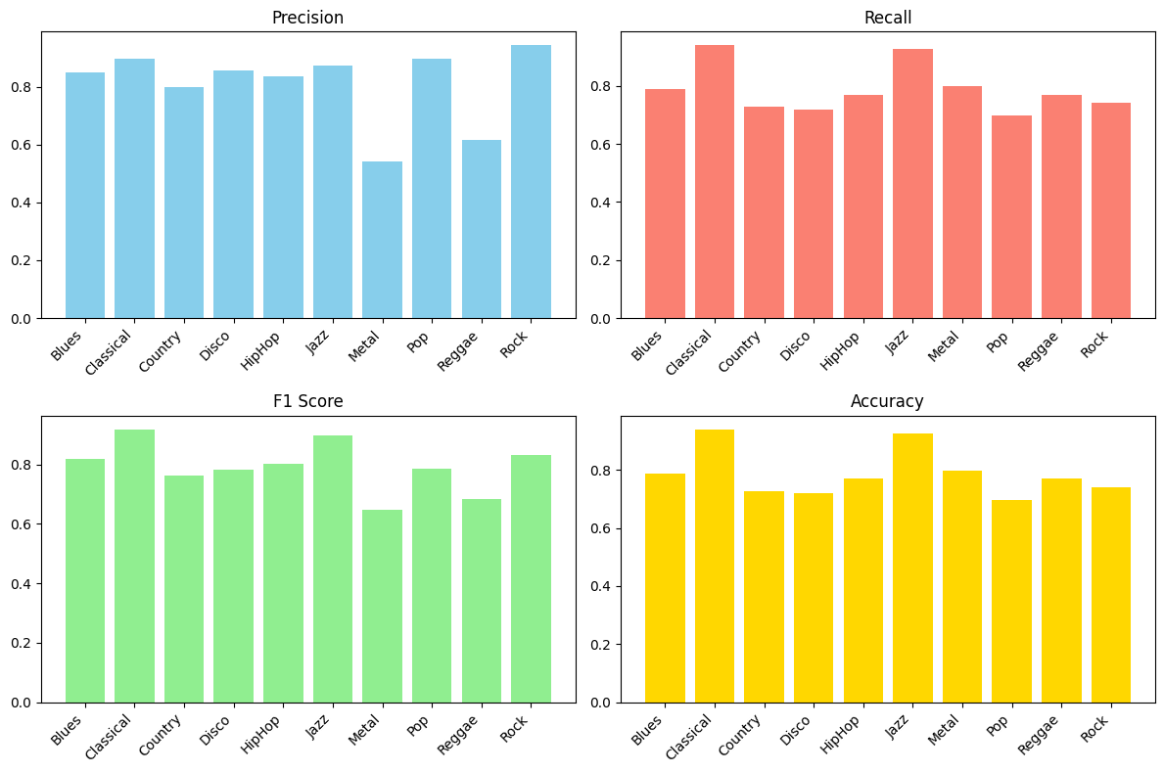
Results
Good results for a model so small:
76% accuracy on training, 66.7% on validation
Confusion Matrix
Validation Diagrams

Slide 9

Conclusions
The authors were not very clear, neither in their results, nor in the way they achieved them. Some things came down to our own interpration, others we had to do ourselves.
The computing resources were a big limitation. We had to tweak some settings in order to make the computation feasible. We are happy with the result we got, because the problem is complex and we managed to get a decent performance with a very small model.

